Slide 1

Algorithms and Data Structures 1 CS 0445
Fall 2023
Runtime Analysis of Recursive Algorithms
Sherif Khattab
ksm73@pitt.edu
(Slides are adapted from Dr. Ramirez’s and Dr. Farnan’s CS 0445 slides.)

Slide 2
Announcements
Upcoming Deadlines:
Homework 7: Thursday 11/2 @ 11:59 pm
Programming Assignment 3: Friday 11/3 @ 11:59 pm
Midterm Questions Redo: Tues. 11/7 @ 11:59 pm
up to 7 points back

Slide 3
Note on Backtracking
In Backtracking, recursion is on decisions, not on input size
We ask friend to help us with the rest of decisions
not with smaller problems
Decisions Examples:
8-Queens: placing the queens, one at a time
Word Search: finding letters of the word, one at a time
Sudoku puzzle: filling empty squares, one at a time

Slide 4
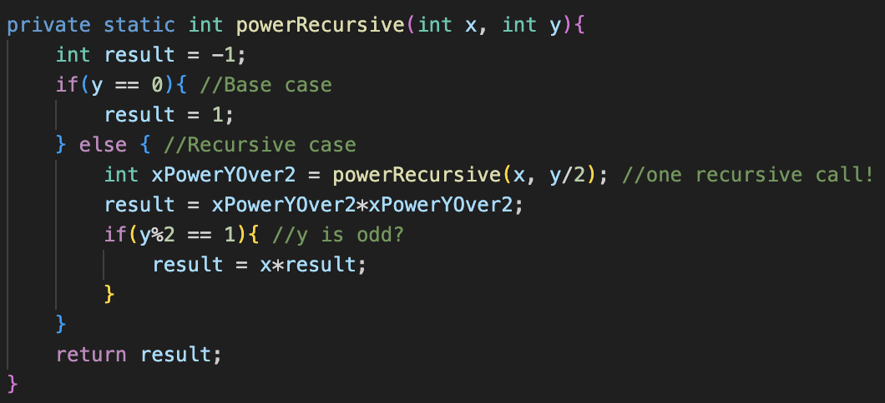
Example 2: powerRecursive
Assume the running time of powerRecursive is a function of exponent y: T(y)
T(y) = O(1) + running time of power(x, y/2)
What is the running time of power(x, y/2)?
Can we use the function T(y)?
Yes! The running time of power(x, y/2) is T(y/2)
T(y) = T(y/2) + O(1)
Base Case: T(1) = O(1)
1
x

Slide 5
Recurrence Relation for powerRecursive
We have a recurrence relation!
T(1) = 1 … (1)
T(y) = T(y/2) + 1 for y>1 … (2)
The above equations called Recurrence Relation
Guess a closed form for T(y)
T(2) = T(1) + 1 = 2
T(4) = T(2) + 1 = 2 + 1 = 3
T(8) = T(4) + 1 = 3 + 1 = 4
T(16) = T(8) + 1 = 4 + 1 = 5
When y doubles → T(y) increases by 1
Intuition: T(y) is logarithmic in y
T(y) = log(y) + 1 … (3)
Let’s prove (3) by induction

Slide 6
Proof by Induction for T(y) of powerRecursive
P(y): T(y) = log(y) + 1 for y>=1 … (3)
Base Case: Prove P(1): T(1) = log(1) + 1
From (1) in Recurrence Relation: LHS = T(1) = 1
RHS = log(1) + 1 = 0 + 1 = LHS
Induction Hypothesis: (I.H.)
Assume P(y) holds for all y < k
T(y) = log(y) + 1 for all y < k
Induction Step: Prove P(k): T(k) = log(k) + 1
LHS = T(k) = T(k/2) + 1 … from (2) in Recurrence Relation
= log(k/2) + 1 + 1 … from I.H.
= log(k/2) + 2
= log(k/2) + log 4
= log((k/2)*4) = log(2k)
= log k + log 2
= log k + 1 = RHS
So, the running time of powerRecursive is log(y) + 1 = O(log y)
T(1) = 1 … (1)
T(y) = T(y/2) + 1 for y>1 … (2)

Slide 7
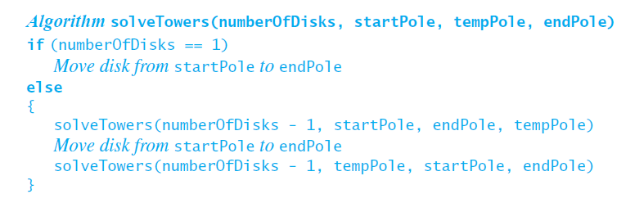
Example 3: Towers of Hanoi Problem
Recursive algorithm to solve any number of disks.

Slide 8
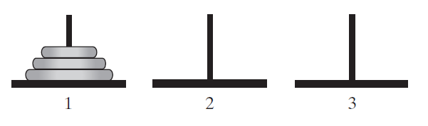
Recurrence Relation for Towers of Hanoi
Assume running time of solveTowers is a function T(n) of input size n
What is n in this problem?
number of disks to move
T(1) = 1
T(n) = 2*running time of solveTowers(numberOfDisks – 1) + 1
= 2*T(n-1) + 1

Slide 9
Recurrence Relation for Towers of Hanoi
Step 1: Recurrence Relation for the running time function T(n)
T(1) = 1
T(n) = 2T(n-1) + 1 for n > 1
Step 2: Guess a closed form for T(n)
By evaluating T(n) for small values of n
T(2) = 2T(1) + 1 = 3
T(3) = 2T(2) + 1 = 7
T(4) = 2T(3) + 1 = 15
T(5) = 2T(4) + 1 = 31
…
not linear
increase n by 1 → almost doubling of T(n)
exponential function
T(n) = 2^{n}
would that work?
Nope, why?
T(n) = 2^{n} - 1

Slide 10
Proof by Induction for T(n) of Towers of Hanoi
P(n): T(n) = 2^{n} – 1 for n >= 1
Base Case: Prove P(1): T(1) = 2¹-1
LHS = T(1) = 1 … from (1)
RHS = 2¹ – 1 = 2 – 1 = 1 = LHS
Induction Hypothesis (I.H.):
Assume P(n) holds for all values n < k
T(n) = 2^{n} – 1 for n < k
Induction Step: Prove P(k): T(k) = 2^{k} - 1
LHS = T(k) = 2 T(k-1) + 1 … from (2)
= 2 (2^{k-1} - 1) + 1 from I.H.
= 2^{k} – 2 + 1 = 2^{k} – 1 = RHS
So, the running time of solveTowers is 2^{n} – 1 = O(2^{n})
T(1) = 1 … (1)
T(n) = 2T(n-1) + 1 for n>1 … (2)

Slide 11
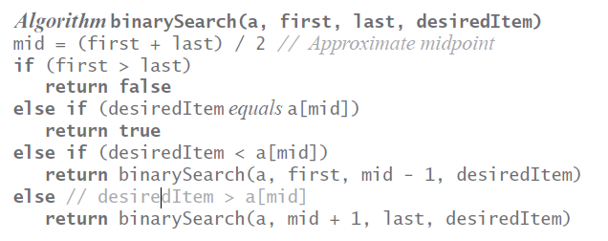
Example 4: Binary Search

Slide 12
Recurrence Relation for Binary Search
Assume running time of binarySearch is a function T(n) of input size n
T(1) = 1
T(n) = O(1) + 1*running time of binarySearch on half the array
= T(n/2) + 1
>=

Slide 13
Recurrence Relation for Binary Search
Step 1: Recurrence Relation for the running time function T(n)
T(1) = 1
T(n) = T(n/2) + 1 for n > 1
Step 2: Guess a closed form for T(n)
By evaluating T(n) for small values of n
T(2) = T(1) + 1 = 2
T(4) = T(2) + 1 = 3
T(8) = T(4) + 1 = 4
T(16) = T(8) + 1 = 5
…
not linear
n doubles→ T(n) increases by 1
logarithmic function
T(n) = log n
would that work?
Nope, why?
T(n) = log n + 1

Slide 14
Proof by Induction for T(n) of Binary Search
P(n): T(n) = log n + 1 for n >= 1
Base Case: Prove P(1): T(1) = log 1 + 1
LHS = T(1) = 1 … from (1)
RHS = log 1 + 1 = 0 + 1 = 1 = LHS
Induction Hypothesis (I.H.):
Assume P(n) holds for all values n < k
T(n) = log n + 1 for n < k
Induction Step: Prove P(k): T(k) = log k + 1
LHS = T(k) = T(k/2) + 1 … from (2)
= log (k/2) + 1 + 1 from I.H.
= log (k/2) + log 4 = log 2k = log k + 1 = RHS
So, the running time of binarySearch is log n + 1 = O(log n)
T(1) = 1 … (1)
T(n) = T(n/2) + 1 for n>1 … (2)

Slide 15
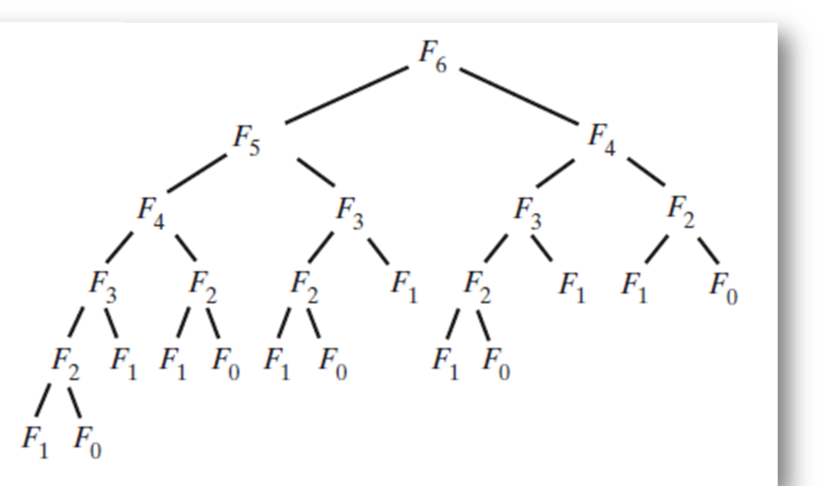
Recursion Tree Analysis
Used recursion tree to trace recursion algorithms
Each node represents one recursive call
Terminal nodes are called leaves
Use recursion tree to estimate the running time of a recursive algorithm
running time = number of nodes * time per node
Recursion tree for Fib(6)

Slide 16
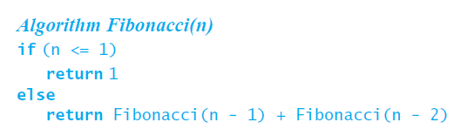
Example 1: Fibonacci numbers
number of nodes almost doubles as we go down level by level
1st level: 1 node
2nd level: 2 nodes
3rd level: 4 nodes
…
number of nodes <= 1 + 2 + 4 + 8 + 16 + ...
How many levels?
number of levels = n
e.g., the recursion tree for F₆ has 6 levels
number of nodes <= 1 + 2 + 4 + 8 + … + 2^{n-1}
<= (a(r^{n -} 1))/(r - 1)
= (1(2^{n}-1))/(2-1) = 2^{n}-1
= O(2^{n})
Running time per node is O(1) (why?)
Total running time = O(2^{n}) * O(1) = O(2^{n})
Exponential!

Slide 17
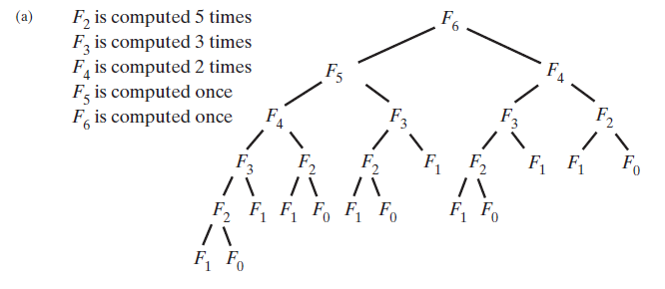
Isn’t that too slow?
Yes! Recursion may lead a poor solution, worse than iterative

Slide 18
Example 2: Towers of Hanoi
Let’s draw the recursion tree for solveTowers on 6 disks

Slide 19
Recursion Tree for Towers of Hanoi
number of nodes doubles as we go down level by level
1st level: 1 node
2nd level: 2 nodes
3rd level: 4 nodes
…
number of nodes = 1 + 2 + 4 + 8 + 16 + ...
How many levels?
number of levels = n
e.g., the recursion tree for solveTowers on 6 disks has 6 levels
number of nodes = 1 + 2 + 4 + 8 + … + 2^{n-1}
<= (a(r^{n -} 1))/(r - 1)
= (1(2^{n}-1))/(2-1) = 2^{n}-1
= O(2^{n})
Running time per node is O(1) (why?)
Total running time = O(2^{n}) * O(1) = O(2^{n})
Exponential!

Slide 20
Example 3: Binary Search
To simplify analysis, we'll cheat a bit:
Assume that the array is cut exactly in half with each iteration
In reality, it may vary by one element either way
Assume that the initial size of the array, n, is an exact power of 2, or 2^{k} for some k
In reality, it can be any value
However, it will not affect our results
Ok, so we have the following:
At call 0: n₀ = 2^{k}
At call 1, n₁ = n₀/2 (in terms of k?)
= 2^{k-1}
At call 2, n₂ = n₁/2 (in terms of k?)
= 2^{k-2}
At call i, n_{i} = n_{i-1}/2 (in terms of k?)
= 2^{k-i}
Last call is when n = 1
= 2⁰

Slide 21
Time complexity of Binary Search
Observation: In call number i, subarray size = 2^{k-i}
How many calls are needed?
In the last call, k-i = 0 → i = k
From call number 0 to call number k?
k+1 calls → k+1 tree nodes
We do one key comparison per call → O(1) time per tree node
Thus, we have a total of (k+1)*1 comparisons maximum
But, n = 2^{k}
So, k = ?
k = log₂n
which makes k + 1 = ?
= log₂n + 1
This leads to our final answer of ?
O(log₂n)

Slide 22
Binary Search on a Sorted Chain
Observation: To find the middle of the chain, traverse the whole chain
Time per call = O(length of sub-chain)
Same number of calls as Binary Search on Sorted Array
Total time = n + n/2 + n/4 + … + 1
= n(1 + ½ + ¼ + … + 1/n)
< n(1 + ½ + ¼ + … + 1/n + …)
= n[(1/(1- ½)]
= n[1/½] = 2n = O(n)
Same asymptotic runtime as sequential search!

Slide 23
Note on input size
Our goal is to model running time in terms of input size
The input size is number of bits needed to represent the input
For the power function, exponent y is represented using how many bits?
log y bits
So, the input size is not y, the exponent value, but …
The input size is log y
So, the recursive power function has O(log y) runtime
This is linear in log y, the input size
So, powerRecursive has linear running time

Slide 24
What is recursion good for?
For some problems, a recursive approach is more natural and simpler to understand than an iterative approach
traversing a linked list backwards
reversing a linked list

Slide 25
What is recursion good for?
For other problems, it is very difficult to even conceive an iterative approach, especially if multiple recursive calls are required in the recursive solution
Towers of Hanoi
Eight Queens

Slide 26
What is recursion good for?
For other problems, a recursive approach allows for a more efficient solution than an iterative approach
e.g., exponentiation x^{y}
General approach is called Divide and Conquer
more examples next week

Slide 27
Divide and Conquer
A problem can be solved by breaking it down to "smaller" problems in a systematic way
subproblems(s) are identical in nature to the original
This is why these problems can be solved quite nicely using recursion
subproblem(s) are a fraction of the size of the original

Slide 28
Divide and Conquer
We can think of each lower level as solving the same problem as the level above
The only difference in each level is the size of the problem, which is ½ of that of the level above it for example
Note how quickly the problem size is reduced

